Slide 1


Slide 2

Enabling Java 2
Runtime Security with Eclipse Plug-ins
___
Analyzing Security Requirements for OSGi-Enabled Platforms
Marco Pistoia, Ted Habeck, Larry Koved
IBM T.J. Watson Research Center
New York, USA

Slide 3


Agenda
Motivation for This Work
Review of Java Security Concepts
IBM Security Workbench Development Environment for Java (SWORD4J)
SWORD4J Demo

Slide 4
1. Motivation for This Work

Slide 5

Developing Secure OSGi Applications
The OSGi framework is a robust platform for deploying and managing applications from handheld devices to servers
It supports security sandboxing by limiting access to resources applications can access at run time
OSGi security is based on the Java 2, Standard Edition (J2SE) security architecture
Eclipse is built on top of the OSGi framework

Slide 6
Authorization – A Layered Perspective
Applications
OSGi Security
J2SE Security

Slide 7
2. Review of Java Security Concepts

Slide 8

Java 2 Stack Inspection Based
Access Control Model
If all the code source was
granted Permission p…
Main.main()
p
?
SecurityException
Socket.<init>("www.ibm.com", 80)
p
?
Otherwise…
sm.checkConnect("www.ibm.com", 80)
p
?
Problem:
What Permissions are required?
Not too many permissions
Not too few permissions
sm.checkPermission(p)
p
?
AccessController.checkPermission(p)
p
?

Slide 9


Same Code, Multiple Call Paths
Client
import java.io.*;
import java.net.*;
public class LibraryCode {
private static String logFileName = "audit.txt";
public static Socket createSocket(String host, int port)
throws UnknownHostException, IOException {
Socket socket = new Socket(host, port);
FileOutputStream fos = new FileOutputStream(logFileName);
BufferedOutputStream bos = new BufferedOutputStream(fos);
PrintStream ps = new PrintStream(bos, true);
ps.print("Socket " + host + ":" + port);
return socket;
}
}
createSocket
Library
Socket
Permission
File
Permission

Slide 10
Multiple Permission Requirements
Client.main()
q
p
LibraryCode.createSocket()
q
p
Socket.<init>(host,port)
q
FileOutputStream.<init>(logFileName)
p
sm.checkConnect(host,port)
q
sm.checkWrite(logFileName)
p
sm.checkPermission(q)
q
sm.checkPermission(p)
p
AccessController.checkPermission(q)
q
AccessController.checkPermission(p)
p
q = new SocketPermission("ibm.com","80");
p = new FilePermission("audit.txt","write");

Slide 11
Need for Privileged Code
import java.io.*;
import java.net.*;
import java.security.*;
public class LibraryCode2 {
private static final String logFileName = "audit.txt";
public static Socket createSocket(String host, int port)
throws UnknownHostException, IOException,
PrivilegedActionException {
Socket socket = new Socket(host, port);
File f = new File(logFileName);
PrivWriteOp op = new PrivWriteOp(host, port, f);
FileOutputStream fos =
(FileOutputStream) AccessController.doPrivileged(op);
BufferedOutputStream bos = new BufferedOutputStream(fos);
PrintStream ps = new PrintStream(bos, true);
ps.print("Socket " + host + ":" + port);
return socket;
}
}
class PrivWriteOp implements PrivilegedExceptionAction {
private File f;
PrivWriteOp (File f) {
this.f = f;
}
public Object run() throws IOException {
return new FileOutputStream(f);
}
}
Client
createSocket
Library
Socket
Permission
File
Permission

Slide 12
Access Control with Privileged Code
Client.main()
q
Library.createSocket()
q
p
Socket.<init>(host,port)
q
AccessController.doPrivileged(op)
p
sm.checkConnect(host,port)
q
op.run()
p
sm.checkPermission(q)
q
FileOutputStream.<init>(logFileName)
p
AccessController.checkPermission(q)
q
sm.checkWrite(logFileName)
p
q = new SocketPermission("ibm.com","80");
sm.checkPermission(p)
p
Problems:
  What portions of library code should be made privileged?
  What permissions are implicitly extended to client code?
  How can unnecessary privileged code be detected?
  How can “tainted variables” be detected?
AccessController.checkPermission(p)
p
p = new FilePermission("audit.txt","write");

Slide 13
OSGi Security Issues
Bundle Developers
  What Java 2 permissions are required?
  Are there inter-plug-in permission dependencies?
  Where should privileged code be inserted?
  Are there any tainted variables?
Administrators
  What Java 2 permissions are required?
  Should all permissions assigned by a bundle provider be trusted?
  Are plug-ins signed and are digital certificates valid?
  Are there inter-plug-in permission dependencies?

Slide 14
What Are Your Choices?
Leave code unmodified
Refactor code so permissions not required by clients. This entails:
  Moving code into initialization routines, etc.
  Adding the required permissions to the associated bundle (policy file)
Treat the privileged operation as a trusted library function. This entails:
  Wrapping the privileged operation in a java.security. PrivilegedAction or PrivilegedExceptionAction
  Adding the required permissions to the associated bundle (policy file)
Notes:
Analysis Logic
Using the analysis tool
While the analysis tool identifies the locations within the code where privileges are required, it does not detail how to appropriately deal with the permission requirement.
There are only 3 options for dealing with a privileged operation.
Treat the privileged operation as a trusted library function. This entails:
wrapping the privileged operation in a privileged action
Adding the required permissions to the associated codebase in the java.policy file.
Add the required permissions to the .java.policy file. In this scenario, all classes on the execution stack must have the required privilege. Any class which does not have the required permission assignment at runtime will throw a security exception.
Refactor the code so that option one is viable.
Deciding which approach to take:
Tainted Variables
A privileged operation typically uses parameters, such as filenames, URLs, usernames, and other inputs. The source of these inputs can "taint" a call to a privileged operation. Example sources are method parameters (supplied by caller) and other objects which return values (e.g. A FileDialog which prompts to the user to supply a path and filename from the filesystem). This is the "tainted variable" concept.
A reference trace is required to determine what codebases (.jar files and classes) ultimately make use of a given method. Eclipse provides a pop-up menu context when a method is selected, "Open Call Heirarchy" which provides the required reference trace. SWORD4J provides a more accurate reference trace. To use SWORD4J's callpath analysis tool, right mouse-click on a permission marker and select "Show callpath".
You would not typically allow a user to read, write, or save a file from any location in the filesystem if you were trying to protect data between applications in a framework such as RCP. You would however, hide the complexities of saving a file so that only the required file privileges need to be specified. (For example, if your library implements logging to track changes, this operation is self contained and could be wrapped in a privileged action so that the caller does not need both java.io.FilePermission "read,write,delete" AND java.util.logging.LoggingPermission "control", "").
Method visibility and Access modifiers
There is also the issue of the encapsulating methods's visibility. If a method is pubic, then any class capable of loading the class with the privileged operation can call it's methods. Great care should be taken when implementing a publicly visible trusted library method to avoid unintentionally elevating the privileges of the caller.
Execute the Analysis tool to identify permission requirements
Specifying analysis entry points.
Locating privileged source code
Display primordial causes of the permission requirements within Eclipse
Display permission requirements in Eclipse.
Process the results:
Treat the privileged operation as a trusted library function. This entails:
Wrapping the privileged operation in a privileged action
Adding the required permissions to the associated codebase in the java.policy file.
Add the required permissions to the .java.policy file. In this scenario, all classes on the execution stack must have the required privilege. Any class which does not have the required permission assignment at runtime will throw a security exception.
Refactor the code so that option one is viable.
Build plug-in / bundle & test with security turned on
Check code into CVS

Slide 15
Traditional Approach
SecurityException
p
q
p
q
q
q
r
r
Client
∅
{p}
SecurityExceptions due to:
Client code being insufficiently authorized
Library code making restricted calls on its own
Limitations:
Tedious, time consuming, and error prone
Some permission and privileged-code requirements may never be discovered until run time due to insufficient number of test cases
Applications may be unstable
Library
AllPermission
p
r
q
Core
AllPermission

Slide 16
A Better Way with SWORD4J
Interprocedural analysis for automatic detection of:
  Library code instructions that are good candidates for becoming privileged
    The candidate instructions are the closest to the library/core boundary
    The permissions implicitly granted to client code are reported
    Explanation for privileged instruction
  “Unnecessary” or “redundant” privileged code
  Permissions required by code
p
Client
p
p
p
PrivilegedAction.
run()
Library
p
AccessController.
doPrivileged(pa)
p
FileOutputStream.
<init>()
p
SecurityManager.
checkPermission(p)
p
AccessController.
checkPermission(p)
Core

Slide 17
3. IBM Security Workbench Development Environment for Java (SWORD4J)

Slide 18
Securing OSGi, Eclipse, and Java Code with SWORD4J
Determining Java 2 security permission requirements
  OSGi bundles
  Eclipse plug-ins
  Java Applications
Authorization
  Adding privileged code where appropriate
  Granting permissions by bundle
Digital key management
  Code signing
  Certificate management
Deployment
  Verify signed bundle signatures
  Verify granted bundle permissions

Slide 19
4. SWORD4J Demo

Slide 20

SWORD4J Architecture
KeyStore Editor
JAR Signer
JAR Inspection
Code Architecture
Inspection
Certificate
Inspection
Permission
Inspection
Static Analysis Engine (Eclipse and OSGi Aware)
Access-Rights
Analysis
Privileged-Code
Placement Analysis
Tainted-Variable
Analysis
Call Path
Analysis
Call Graph
Java Bytecode Analysis (JaBA)
Security Policy
Object Code

Slide 21
SWORD4J Summary
New Eclipse-based analysis tool for inspecting and analyzing OSGi bundles, Eclipse plug-ins, and Java programs
Includes the following plug-ins:
  Java 2 Security Analysis
  Jar Inspection
  Jar Signing
  KeyStore editor
Notes:
Tooling solutions: (To address lifecycle problem):
Worked with Marco Pistoia, and Larry Koved to design and implement the J2SESA plug-in.
Designed and developed the jar Inspection plug-in
Definitions
PISA - Permission Introspection for Safe Authorization
SPAC - Secure Placement of Authorized Code
Because of changes to the core JVM libraries, additional tooling work need to be done to understand and correct.
Next steps – Look at tainted variable analysis.

Slide 22
SWORD4J Features
Security Analyses
  Permission analysis
  Privileged code analysis
Code Signing
  SWORD4J provides a JAR signing GUI
KeyStore Management
  SWORD4J provides a KeyStore editor for managing Java KeyStores
    Change password, edit certificate aliases, export certificates, import certificates, generate self-signed certificates, change key entry passwords, copy key entries between KeyStores
Jar Inspector
  Displays JAR architecture
  Displays Signing information
  Displays OSGi bundle permission requirements.

Slide 23
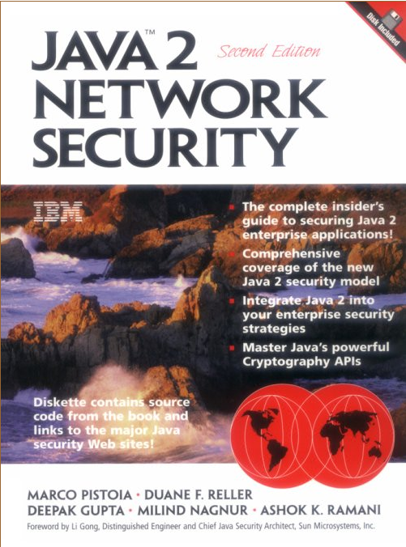
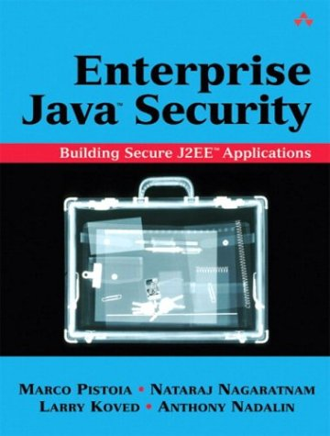
Additional Information – Thank You!
E-mail:
  pistoia@us.ibm.com
  habeck@us.ibm.com
  koved@us.ibm.com
Web
  SWORD4J Download:
    http://www.alphaworks.ibm.com/tech/sword4j
  Personal:
    http://www.research.ibm.com/people/p/pistoia
    http://www.research.ibm.com/people/k/koved
  Java Security Project:
    http://www.research.ibm.com/javasec
  Eclipse security: http://www.eclipse.org/equinox/
Books

